Slide 1
Uva 1292
Strategic Game
Time: 3 seconds

Slide 2
Problem Descriptions (1/2)
Bob enjoys playing computer games, especially strategic games, but sometimes he cannot find the solution fast enough and then he is very sad.
Now he has the following problem. He must defend a medieval city, the roads of which form a tree. He has to put the minimum number of soldiers on the nodes so that they can observe all the edges. Can you help him?

Slide 3
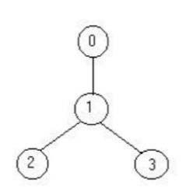
Problem Descriptions (2/2)
Your program should find the minimum number of soldiers that Bob has to put for a given tree.
For example for the tree on the right the solution is one soldier (at the node 1).
put 1 solder at node 1

Slide 4
Input
The input file contains several data sets in text format.
Each data set represents a tree with the following description:
the number of nodes
the description of each node in the following format
node identifier:(number of roads) node identifier1 . . . node identifier_{number of roads}
node identifier:(0)
The node identifiers are integer numbers between 0 and n − 1, for n nodes (0 < n ≤ 1500). Every edge appears only once in the input data.

Slide 5
Output
The output should be printed on the standard output.
For each given input data set, print one integer number in a single line that gives the result (the minimum number of soldiers).

Slide 6
Example I/O
Number of nodes
4
0:(1) 1
1:(2) 2 3
2:(0)
3:(0)
5
3:(3) 1 4 2
1:(1) 0
2:(0)
0:(0)
4:(0)
1
2
Node identifier
Node connected
Number of edges
3
1
4
2
0

Slide 7
DP
dp[i][0]: 代表 node_{i} 不放 的最少士兵個數
dp[i][1]: 代表 node_{i} 放 的最少士兵個數
dp[u][0]+=dp[v][1]
u 不選，則 小孩 v 中必要選
dp[u][1]+=min(dp[v][0], dp[v][1])
u要選， 則小孩 v 要選與不選，挑小的

Slide 8
Example I/O
dp[3][0]=1
dp[3][1]=1
dp[3][0]=2
dp[3][1]=1
dp[3][0]+=dp[4][1]
dp[3][1]+=min(dp[4][0], dp[4][1])
dp[3][0]+=dp[2][1]
dp[3][1]+=min(dp[2][0], dp[2][1])
3
dp[1][0]+=dp[3][1]
dp[1][1]+=min(dp[3][0], dp[3][1])
2
4
3
dp[2][0]=0
dp[2][1]=1
1
4
2
dp[1][0]=1
dp[1][1]=2
1
dp[4][0]=0
dp[4][1]=1
0
dp[0][0]+=dp[1][1]
dp[0][1]+=min(dp[1][0], dp[1][1])
dp[0][0]=2
dp[0][1]=2

Slide 9
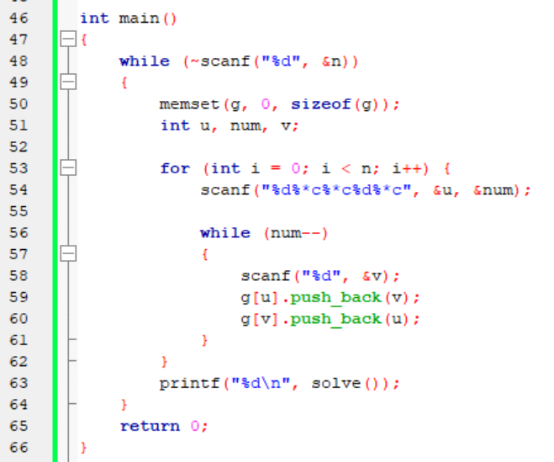
忽略一個字元

Slide 10
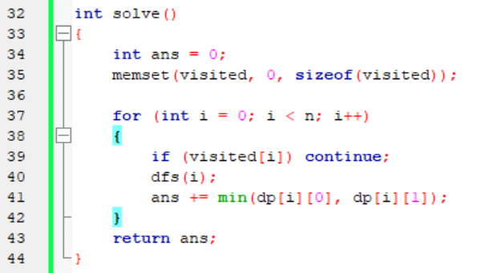

Slide 11
